Slide 1


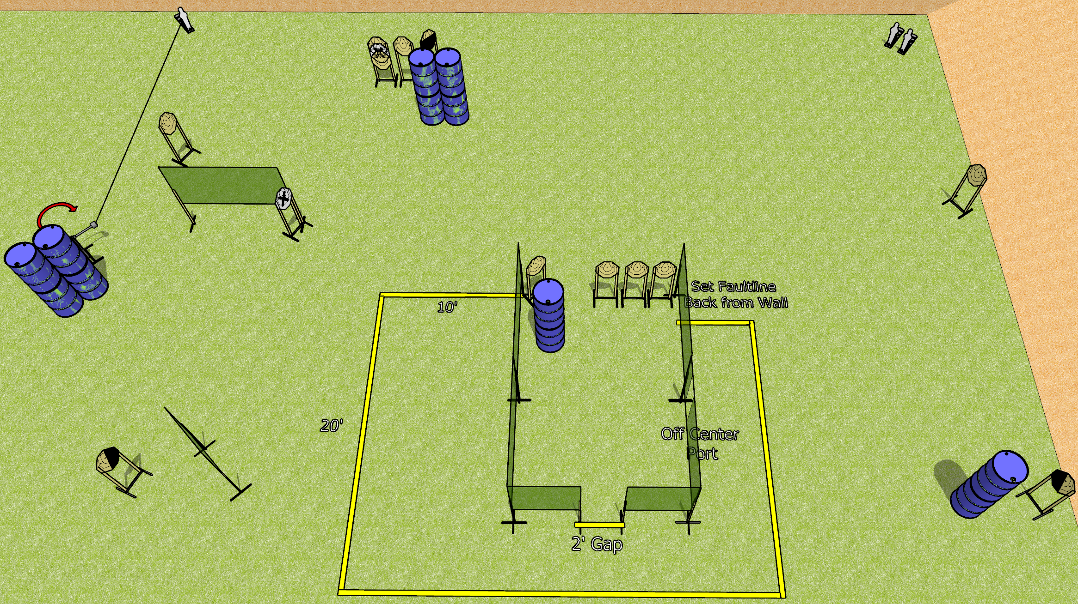
 | Dothan Gun Club – USPSA Match Glitch in the Turtle Course Designer : Drew Coleman
Round Count 29 rounds 13 IPSC 3 mini poppers
Equipment List 1 medium fault line, 1 small fault line 12 wall feet 1 swinger + activator 1 left and 1 right diagonal, 1 50%
15’

Slide 2
Glitch in the Turtle
Written Stage Briefing
Glitch in the Turtle is a 29 round, 145 point, Comstock course of fire. There are 13 IPSC targets and 3 mini poppers. The best 2 hits on paper will score, and steel must fall to score. The start signal is audible.
The swinger is activated by the left mini popper and remains visible at rest.
Handgun start position is inside the shooting area, wrists below belt. Handgun is loaded and holstered.
PCC start position is inside the shooting area, stock on belt. Loaded carbine is held with both hands, safety on.
On start signal, engage targets as they become available from within the shooting area.

